Slide 1
ASP.Net Core –Building forms with Tag Helpers
Kamal Beydoun
Lebanese University – Faculty of Sciences I
Kamal.beydoun@ul.edu.lb

Slide 2
Introduction
Tag Helpers are new to ASP.NET Core and for server-side HTML rendering.
They’re Razor components that you can use to customize the HTML generated in your templates.
Tag Helpers can be added to a standard HTML element, such as an <input>.
They can also be standalone elements and can be used to generate completely customized HTML.
Notes:
Remember, Razor, and therefore Tag Helpers, are for server-side HTML rendering. You can’t use Tag Helpers directly in frontend frameworks like Angular or React.

Slide 3
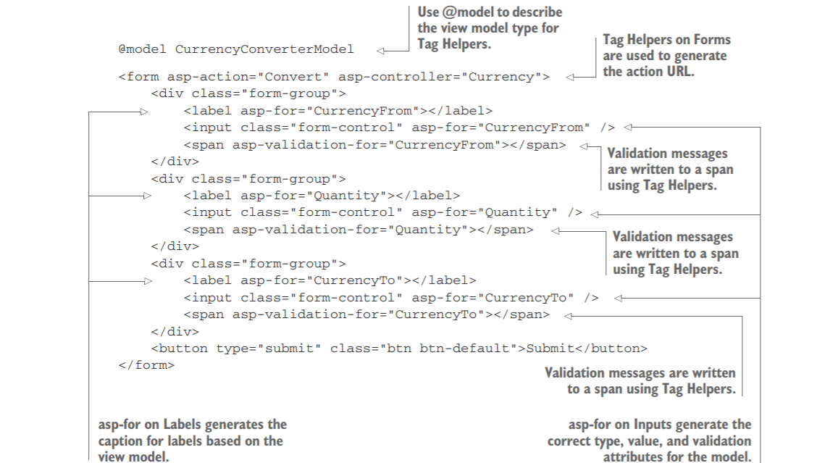
Notes:
This is an example…It will be explained in details later.
Notice that listing 8.1 didn’t specify the captions to display in the labels. Instead, you declaratively used asp-for="CurrencyFrom" to say, “for this , use the CurrencyFrom property to work out what caption to use.

Slide 4
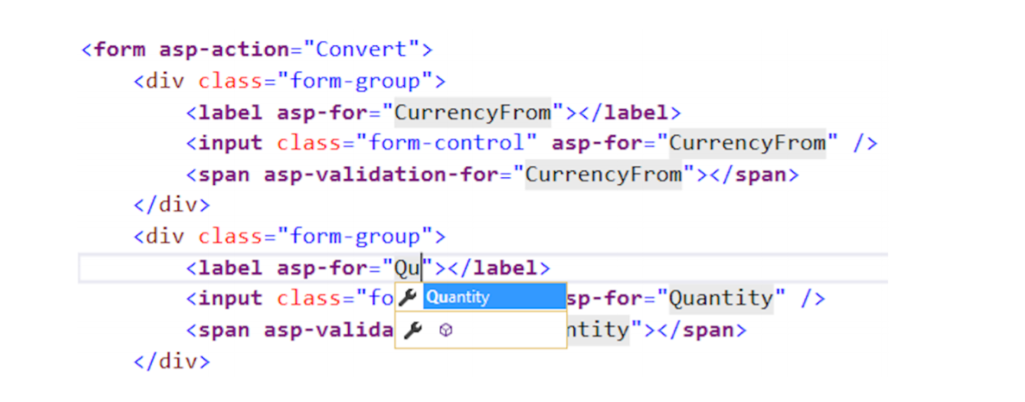
Tag Helpers vs Html elements
In Visual Studio, Tag Helpers are distinguishable from normal elements by being bold and a different color, C# is shaded, and IntelliSense is available.

Slide 5
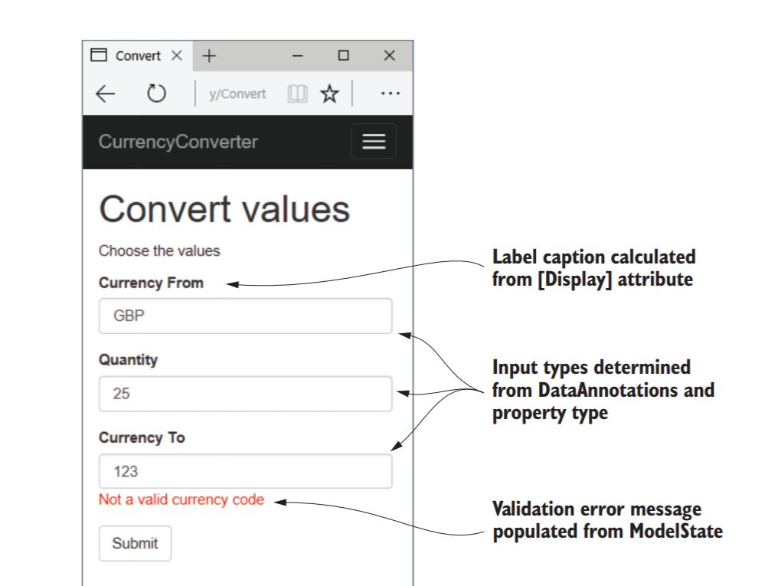
Why Tag Helpers ?
Let us easily integrate server-side values, such as those in your view model, with the generated HTML.
Tag Helpers are used to
Automatically populate the values from the view model.
Choose the correct input type to display.
Display any validation errors.
Notes:
Tag Helpers are extra attributes on standard HTML elements (or new elements entirely) that work by modifying the HTML element they’re attached to.
Notice that listing 8.1 didn’t specify the captions to display in the labels. Instead, you declaratively used asp-for="CurrencyFrom" to say, “for this , use the CurrencyFrom property to work out what caption to use.”
To learn more about the internals of Tag Helpers, read the documentation at http://mng.bz/Idb0.

Slide 6
Creating forms using Tag Helpers
You can use Tag Helpers
to generate HTML markup based on properties of your view model,
creating the correct id and name attributes of the element
setting the value of the element to the model property’s value
Notes:
Tag Helpers can perform a variety of functions by modifying the HTML elements they’re applied to.
This chapter introduces a number of the common Tag Helpers and how to use them, but it’s not an exhaustive list. I don’t cover all of the helpers that come out of the box in ASP.NET Core (there are more coming with every release!), and you can easily create your own, as you’ll see in chapter 18.
Alternatively, you could use those published by others on NuGet or GitHub.3 As with all of ASP.NET Core, Microsoft is developing Tag Helpers in the open on GitHub, so you can always take a look at the source to see how they’re implemented.

Slide 7
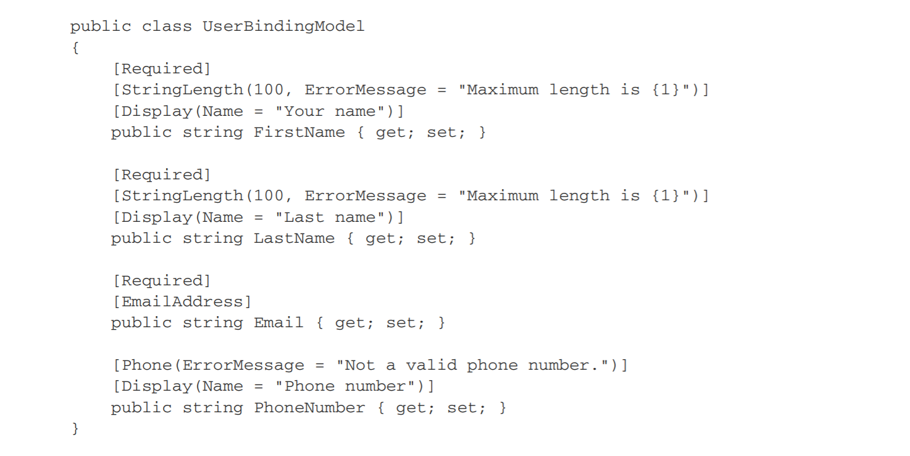
DataAnnotations Attributes
These attributes are also used by the Razor templating language to provide the metadata required to generate the correct HTML when you use Tag Helpers.
For simplicity, We are using the same object for both binding model and view model, but in practice you should use two separate objects.
Notes:
For simplicity, I’m using the same object for both my binding model and view model, but in practice you should use two separate objects to avoid mass-assignment attacks on your app.

Slide 8
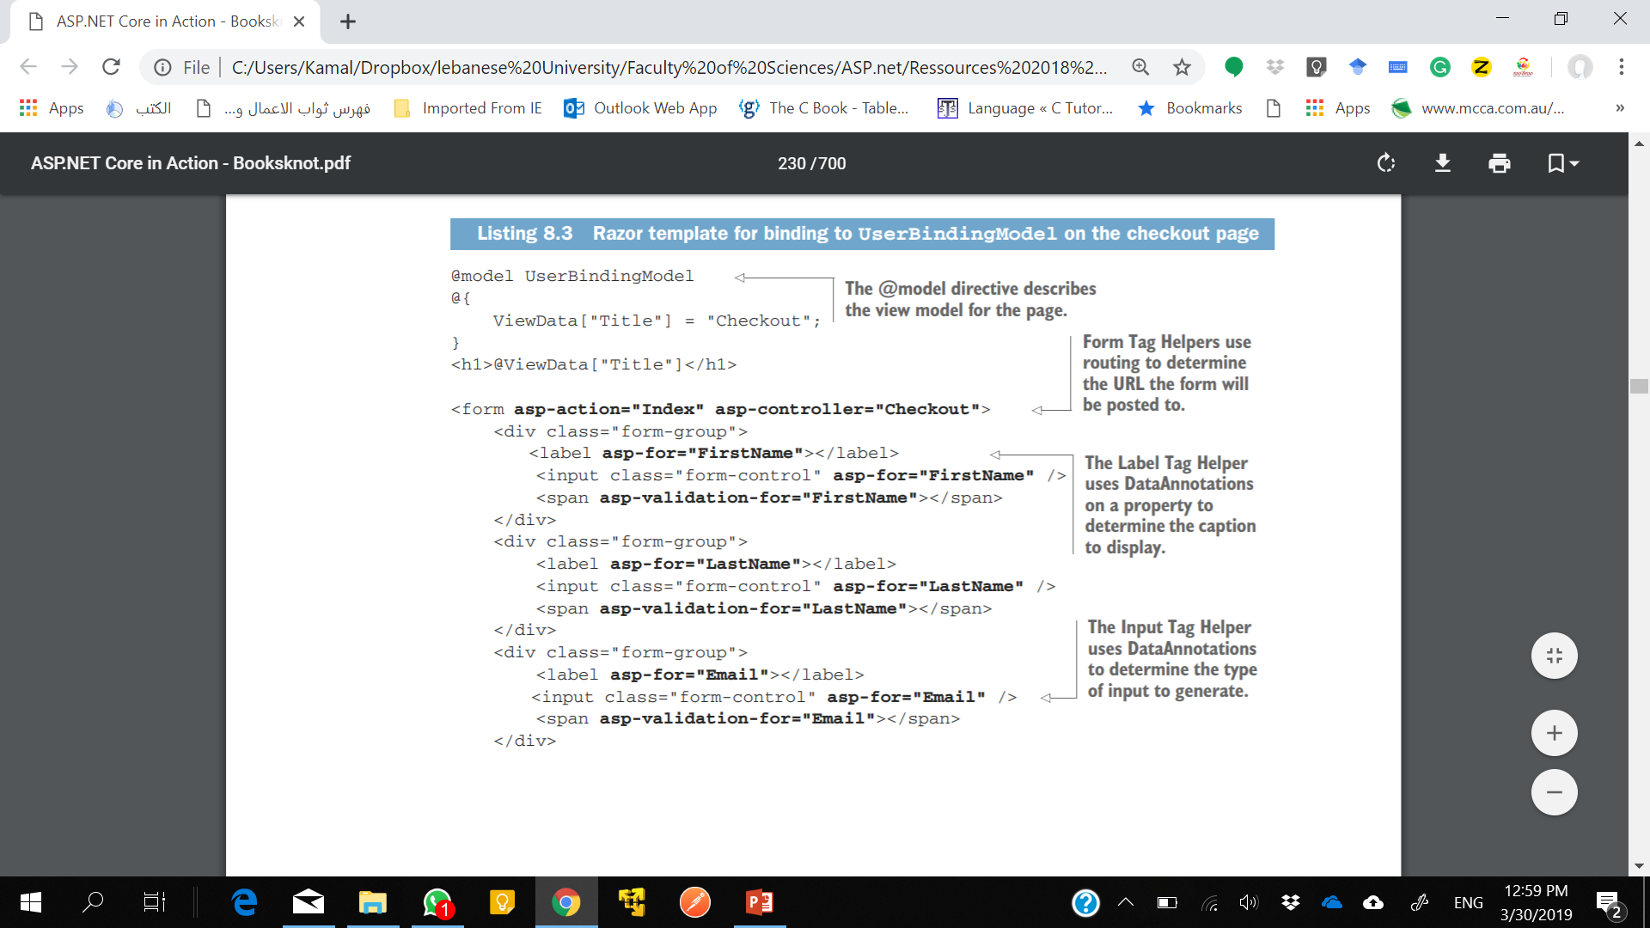
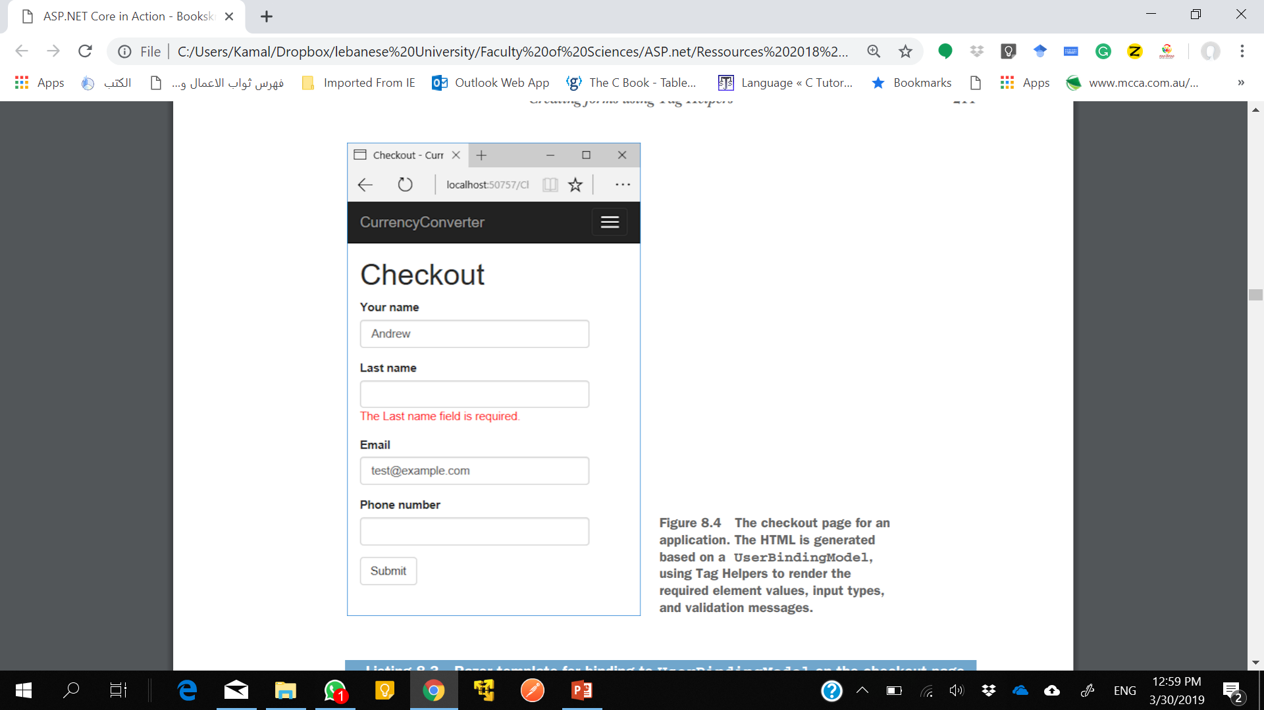
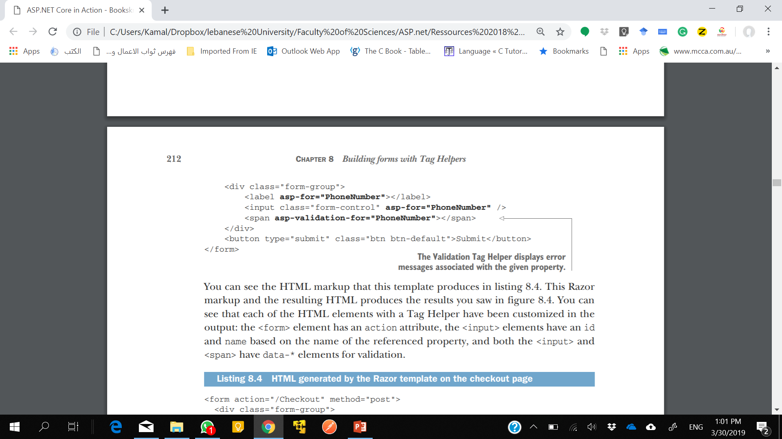

Slide 9
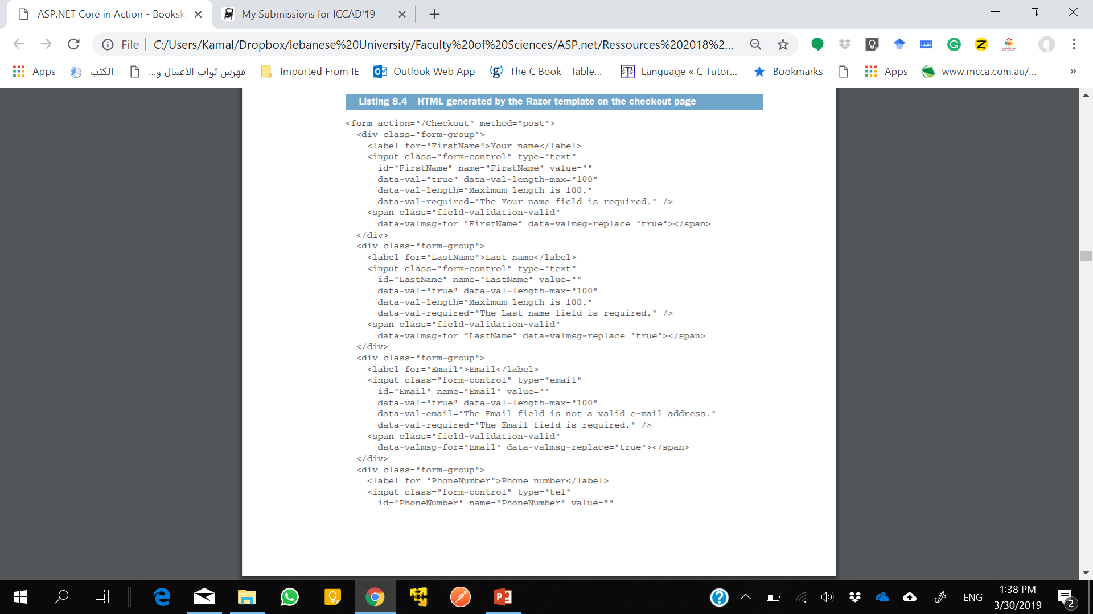
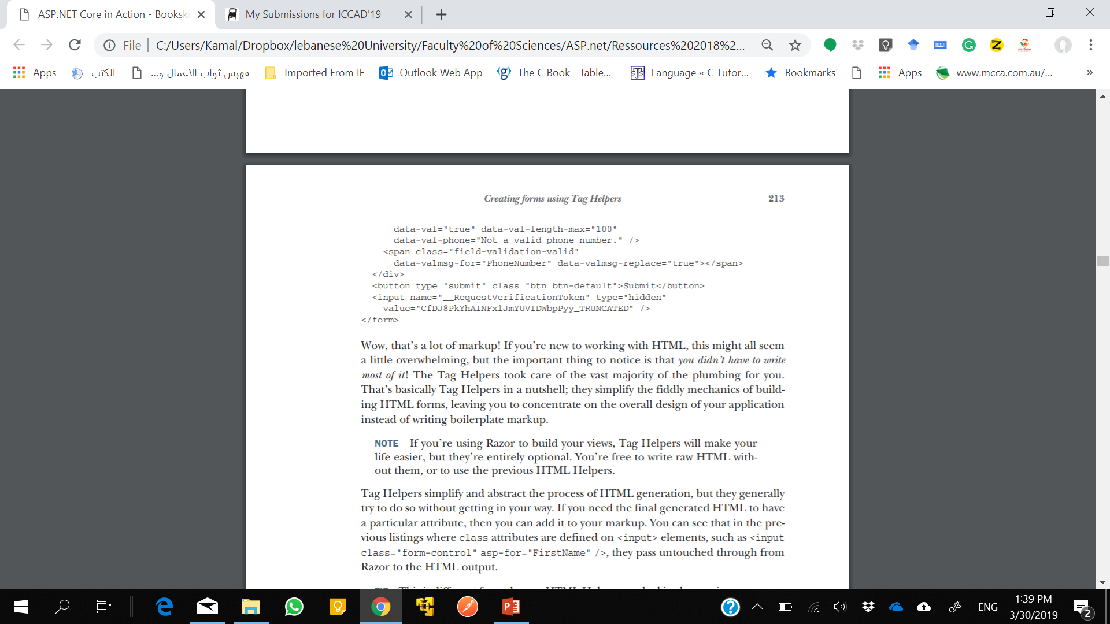
Notes:
If you’re using Razor to build your views, Tag Helpers will make your
life easier, but they’re entirely optional. You’re free to write raw HTML without them, or to use the previous HTML Helpers.

Slide 10
asp-action and asp-controller
<form asp-action="Index" asp-controller="Checkout">
This resulted in the addition of action and method attributes to the final HTML, indicating the URL that the form should be sent to when submitted:
<form action="/Checkout" method="post">

Slide 11
asp-route-*
Used to set arbitrary route parameters. If you have a route : {controller}/{action}/{id?}
<form asp-action="View" asp-controller="Product“ asp-route-id="5">
Will generate:
<form action="/Product/View/5" method="post">

Slide 12
asp-route
Use the asp-route attribute to specify the route name to use,
Use the asp-route-* attributes to specify the route parameters to use during URL generation.
routes.MapRoute( name: "view_posts",
template: "{username}/posts",
defaults: new {controller="User", action="ViewPosts");
<form asp-route="view_posts" asp-route-username="@Model.Username">

Slide 13
The Label Tag Helper
Used to generate the caption (the visible text) and the for attribute for a <label> element, based on the properties in the view model.
[Display] DataAnnotations attribute determines the appropriate value to display.
public class UserBindingModel
{
[Display(Name = "Your name")]
public string FirstName { get; set; }
public string Email { get; set; }
}
The following Razor:
<label asp-for="FirstName"></label>
<label asp-for="Email"></label>
would generate the HTML
<label for="FirstName">Your Name</label>
<label for="Email">Email</label>
Notes:
If the property you’re generating a label for doesn’t have a [Display] attribute, the Label Tag Helper will use the name of the property instead.
NOTE The for attribute is important for accessibility. It specifies the ID of the element to which the label refers.
For a <label> to work properly, it must include a for attribute, which identifies the <input> to which it is associated. The for attribute's value should match the id (not the name) of the <input> element.

Slide 14
The Label Tag Helper
If you don’t want to use the caption generated by the helper, you could insert your own manually.
<label asp-for="Email">Please enter your Email</label>
would generate the HTML
<label for="Email">Please enter your Email</label>

Slide 15
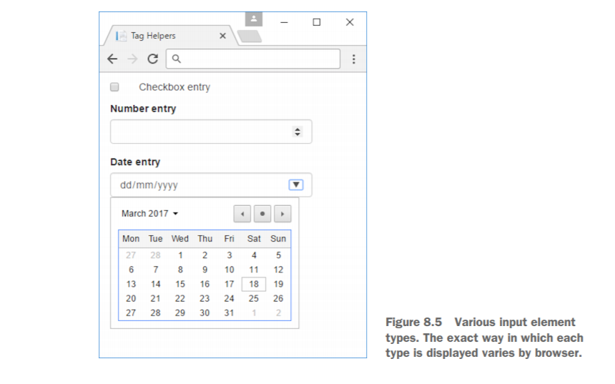
The Input and Textarea Tag Helpers

Slide 16
The Input and Textarea Tag Helpers
To determine the type of the input element to generate, Tag Helpers uses information based on:
the type of the property (bool, string, int, and so on)
DataAnnotations attributes applied to the property
DataAnnotations are also used to add data-val-* client-side validation attributes to the generated HTML.

Slide 17
Example
<input asp-for="Email" />
Will generate
<input type="email" id="Email" name="Email"
value="test@example.com" data-val="true"
data-val-email="The Email Address field is not a valid e-mail address."
data-val-required="The Email Address field is required."
/>
Notes:
The property is a string, so ordinarily, the Input Tag Helper would generate an <input> with type="text".
But the addition of the [EmailAddress] attribute provides additional metadata about the property. Consequently, the Tag Helper generates an HTML5 <input> with type="email":
Perhaps the most striking addition is the swath of data-val-* attributes. These can be used by client-side JavaScript libraries such as jQuery to provide client-side validation of your DataAnnotations constraints.

Slide 18
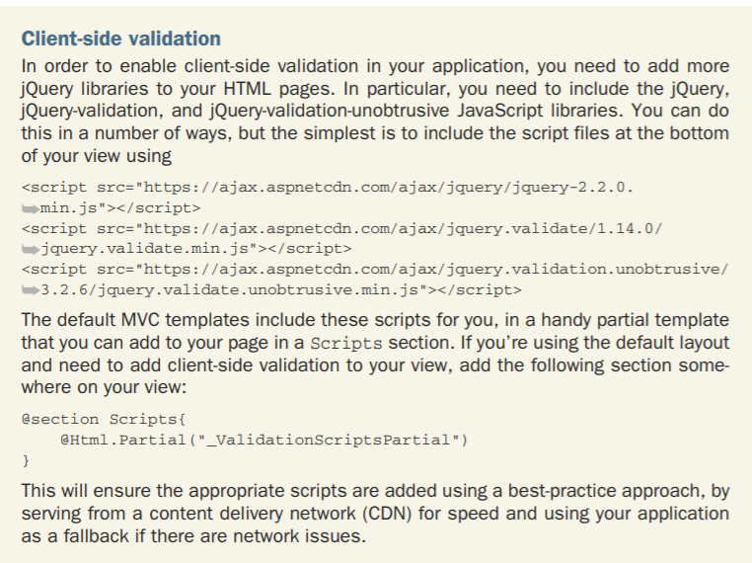

Slide 19
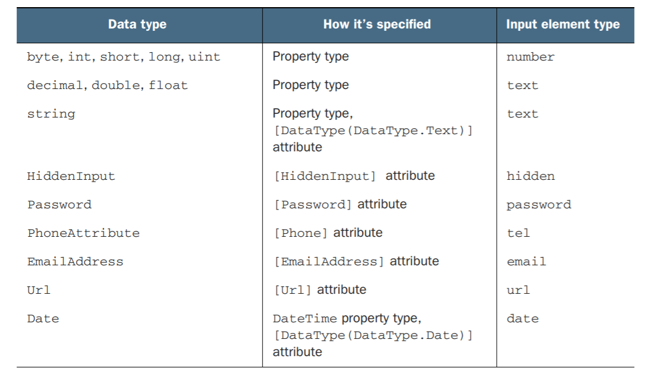
Input Tag Helpers
As always, you can override the generated type by adding your own type attribute to the Razor.
Notes:
The Input Tag Helper tries to pick the most appropriate template for a given property based on DataAnnotation attributes or the type of the property.

Slide 20
asp-format
To customize the way data is displayed: asp-format.
<input asp-for="Dec" asp-format="0.000" />
If the Dec property had a value of 1.2, this would generate HTML similar to
<input type="text" id="Dec" name="Dec" value="1.200">
Notes:
HTML forms are entirely string-based, so when the value of an element is set, the Input Tag Helper must take the value stored in the property and convert it to a string. Under the covers, this performs a string.Format() on the property’s value, passing in a format string.

Slide 21
Text Area Tag Helper
<textarea asp-for="Multiline"></textarea>
generates
<textarea data-val="true" id="Multiline" name="Multiline"
data-val-length="Maximum length 200." data-val-length-max="200"
data-val-required="The Multiline field is required." >This is some text,
I'm going to display itin a text area</textarea>
Notes:
But this is more than reducing the number of keystrokes required; Tag Helpers ensure that the markup generated is correct, and has the correct name, id, and format to automatically bind your binding models when they’re sent to the server.
Note that the property value is rendered inside the Tag, and data-val-* validation elements are attached as usual:

Slide 22
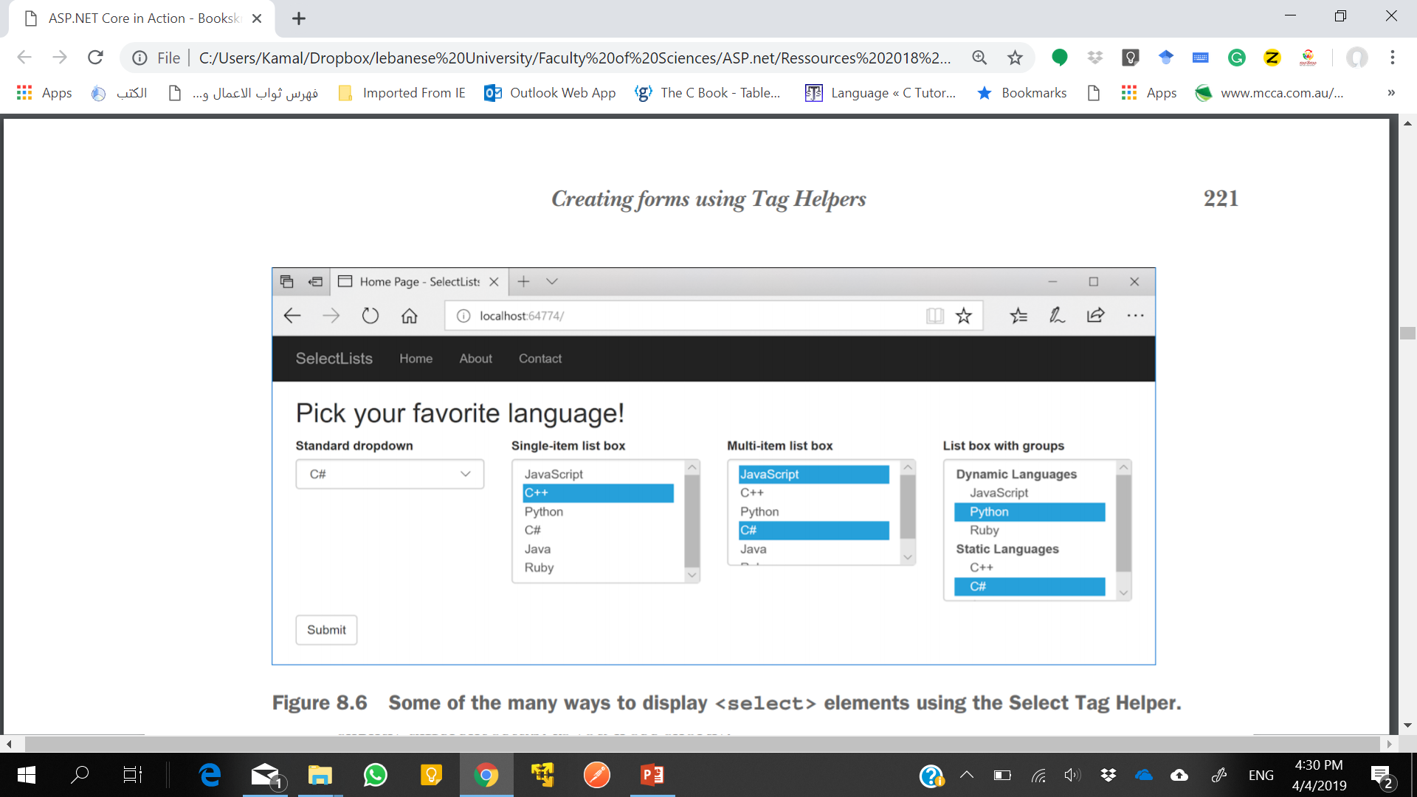
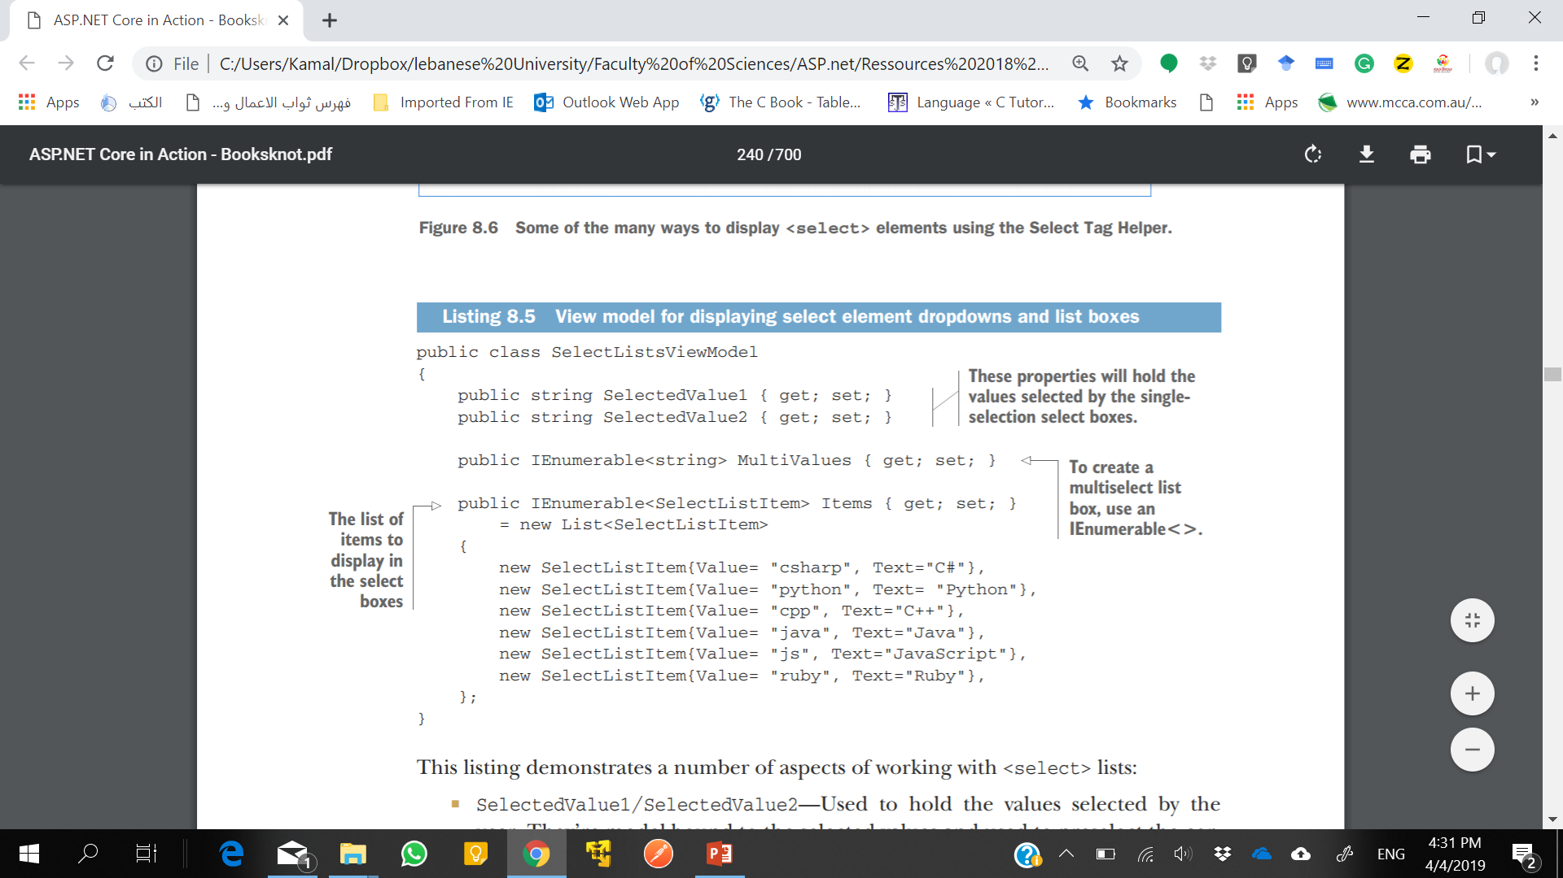
The Select Tag Helper
The Select Tag Helper only works with SelectListItem elements.
Notes:
This listing demonstrates a number of aspects of working with <select> lists:
○ SelectedValue1/SelectedValue2—Used to hold the values selected by the user. They’re model-bound to the selected values and used to preselect the correct item when rendering the form.
○ MultiValues—Used to hold the selected values for a multiselect list. It’s an IEnumerable, so it can hold more than one selection per <select> element.
○ Items—Provides the list of options to display in the <select> elements. Note that the element type must be SelectListItem, which exposes the Value and Text properties, to work with the Select Tag Helper
The Select Tag Helper only works with SelectListItem elements. That means you’ll normally have to convert from an application-specific list set of items (for example, a List or List) to the UIcentric List. But hey, that’s why we have view models!

Slide 23
The Select Tag Helper
As for the Input Tag Helper, the asp-for attribute specifies the property in your view model to bind to.
The asp-items attribute is provided the IEnumerable<SelectListItem> to display the available <option>.
Notes:
P It’s common to want to display a list of enum options in a <select> list.
This is so common that ASP.NET Core ships with a helper for generating a SelectListItem for any enum. If you have an enum of the TEnum type, you can generate the available options in your View using asp-items="Html.GetEnumSelectList<TEnum>()".

Slide 24
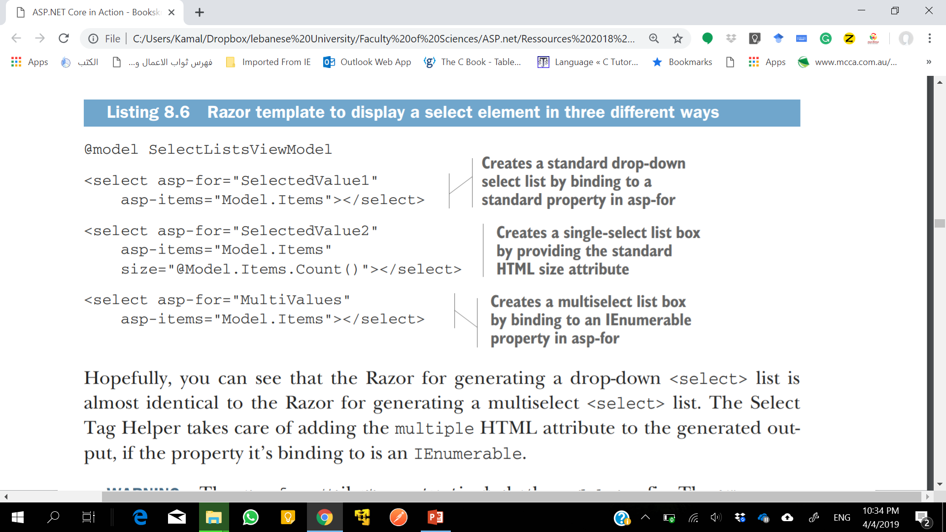
select element in Razor
Notes:
Hopefully, you can see that the Razor for generating a drop-down <select> list is almost identical to the Razor for generating a multiselect <select> list. The Select Tag Helper takes care of adding the multiple HTML attribute to the generated output, if the property it’s binding to is an IEnumerable.
The asp-for attribute must not include the Model. prefix. The asp-items attribute, on the other hand, must include it if referencing a property on the view model. The asp-items attribute can also reference other C# items, such as objects stored in ViewData, but using the view model is the best approach.

Slide 25
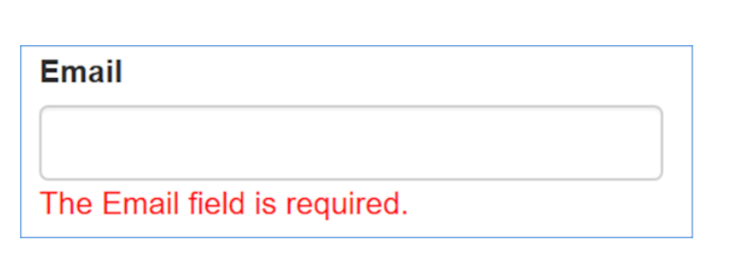
The Validation Message Tag Helper
This can be achieved for each property in your view model using the Validation Message Tag Helper applied to a <span> by using the asp-validation-for attribute:
<span asp-validation-for="Email"></span>
When an error occurs during client-side validation or server-side validation , the appropriate error message for the referenced property will be displayed in the <span>.
Notes:
When an error occurs during client-side validation, the appropriate error message for the referenced property will be displayed in the <span>.
This element will also be used to show appropriate validation messages if server-side validation fails, and the form is being redisplayed.

Slide 26
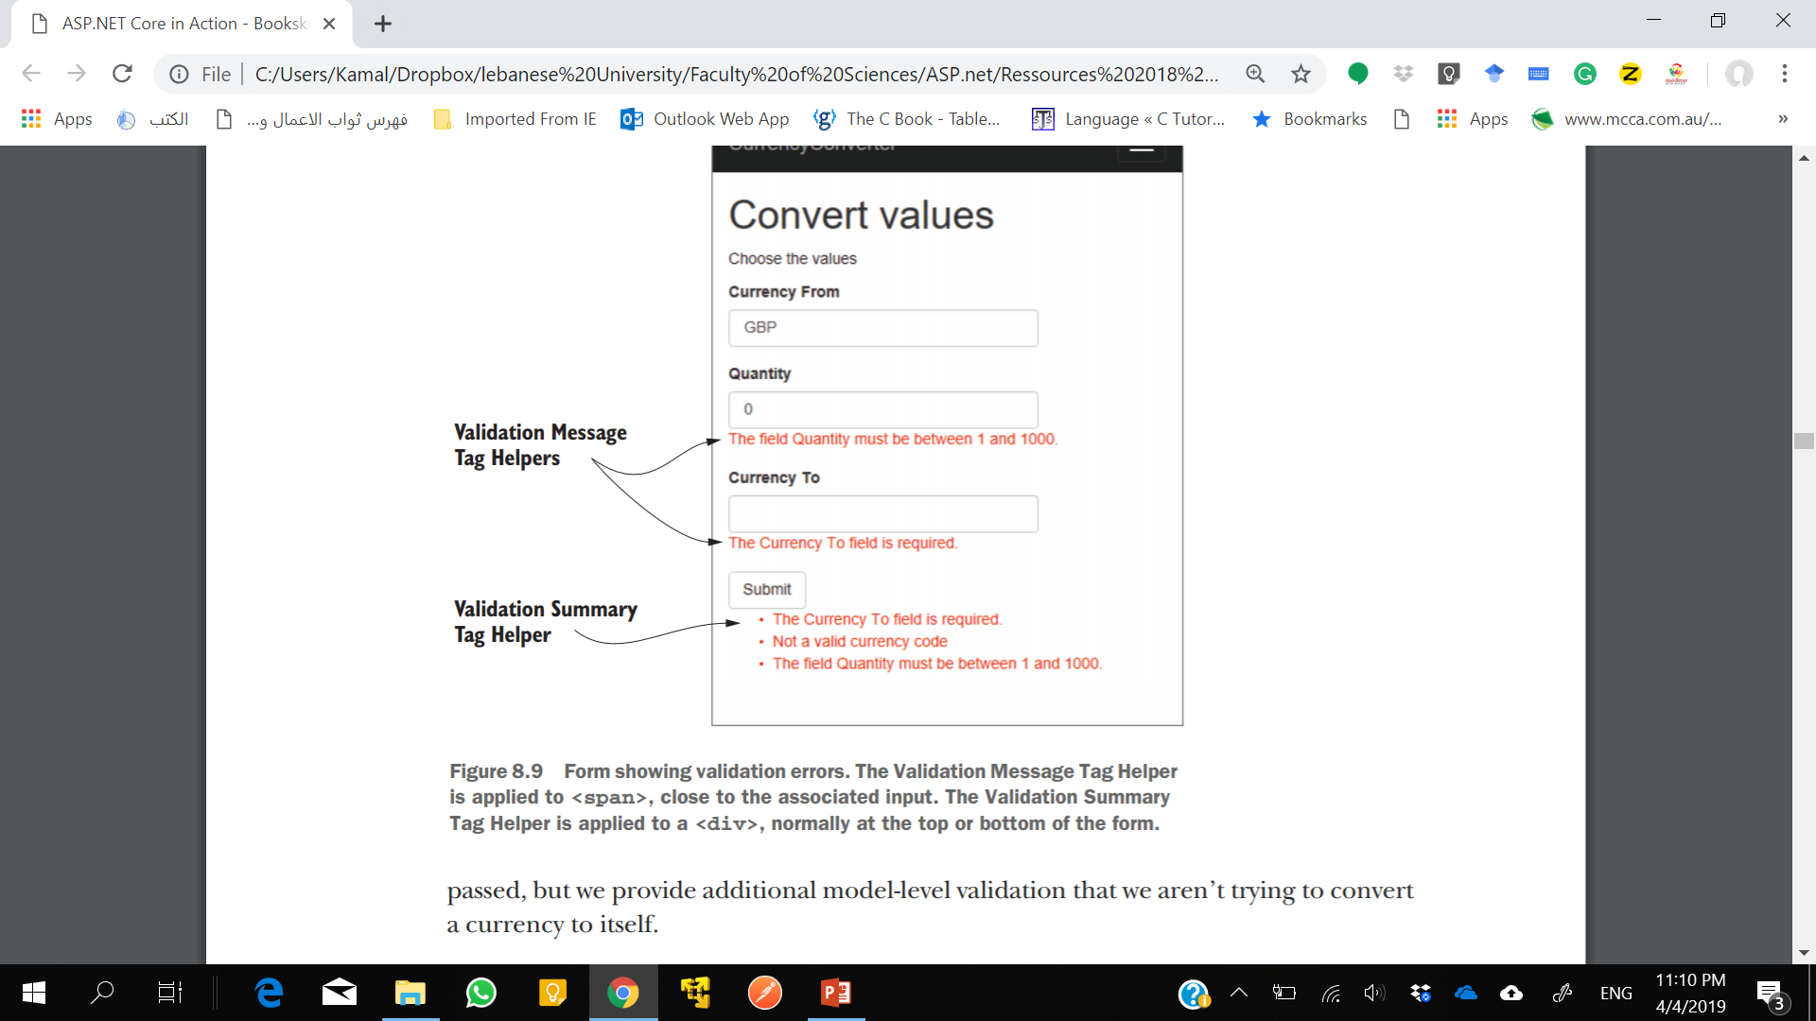
Validation Summary Tag Helper
Applied to a <div> using the asp-validation-summary attribute and providing a ValidationSummary enum value, such as:
<div asp-validation-summary="All"></div>
The ValidationSummary enum controls which values are displayed, and has three possible values:
None—Don’t display a summary.
ModelOnly—Only display errors that are not associated with a property.
All—Display errors either associated with a property or with the model.

Slide 27
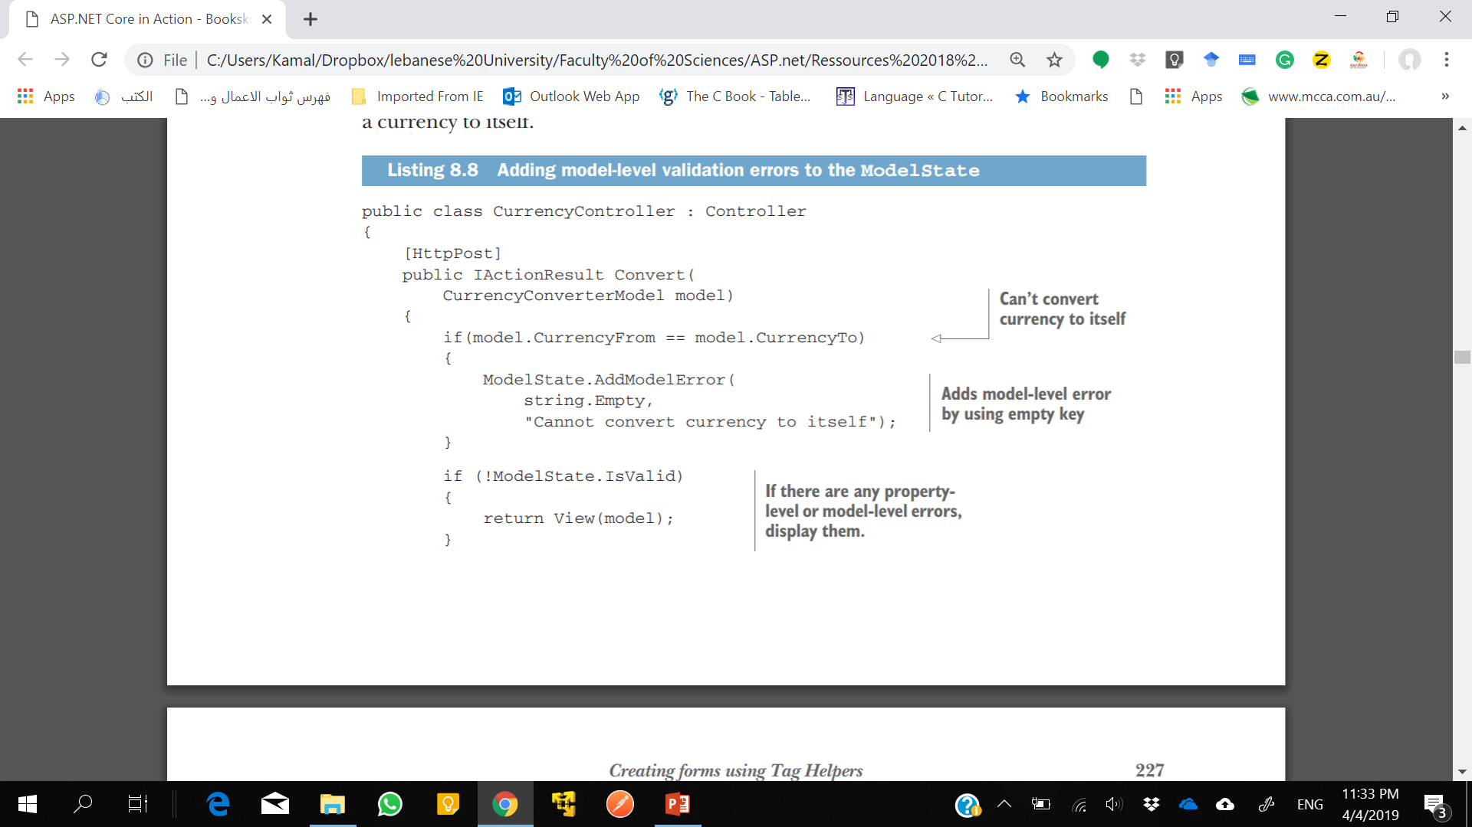
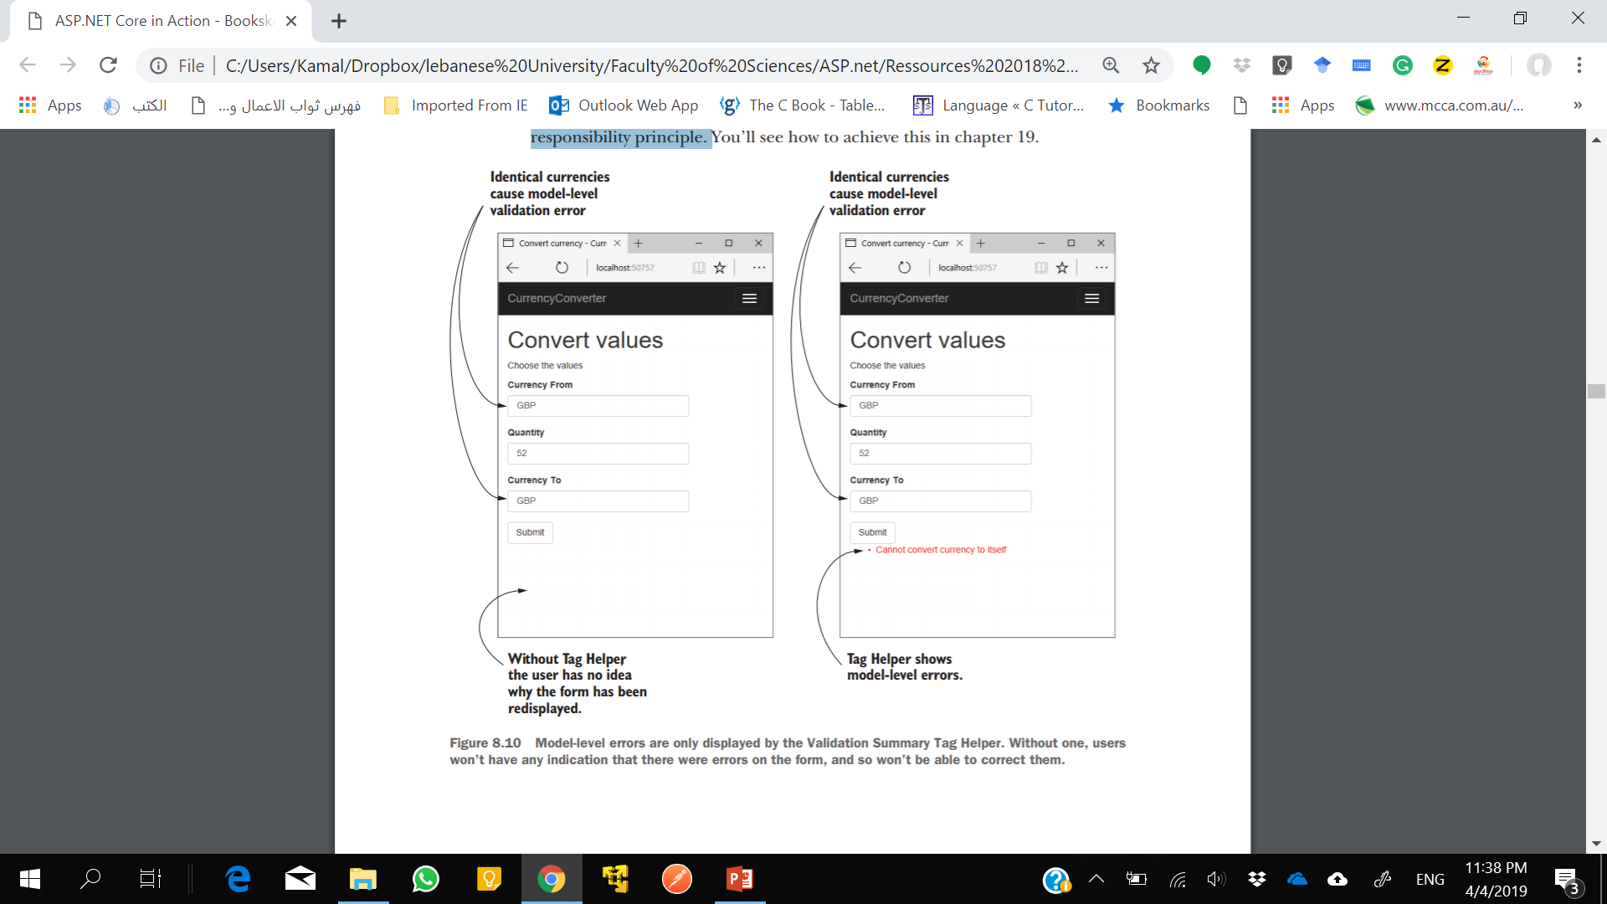
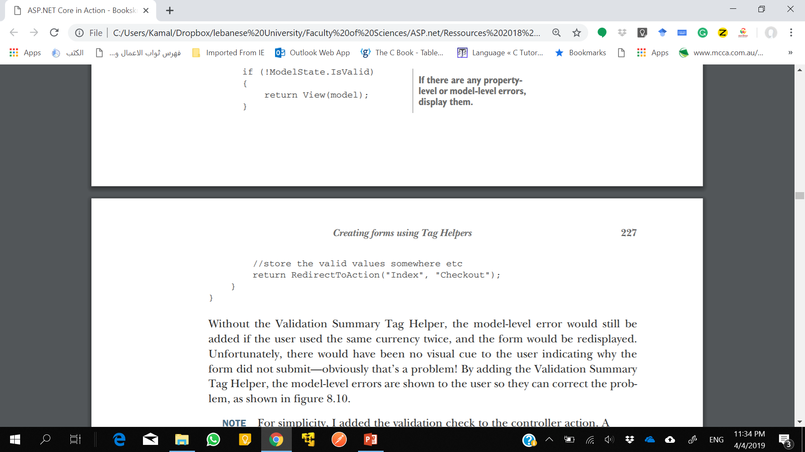
Notes:
The Validation Summary Tag Helper is particularly useful if you have errors associated with your view model that aren’t specific to a property. These can be added to the model state by using a blank key, as shown in listing.
For simplicity, I added the validation check to the controller action. A better approach might be to create a custom validation attribute to achieve this instead. That way, your controller stays lean and sticks to the single responsibility principle.

Slide 28
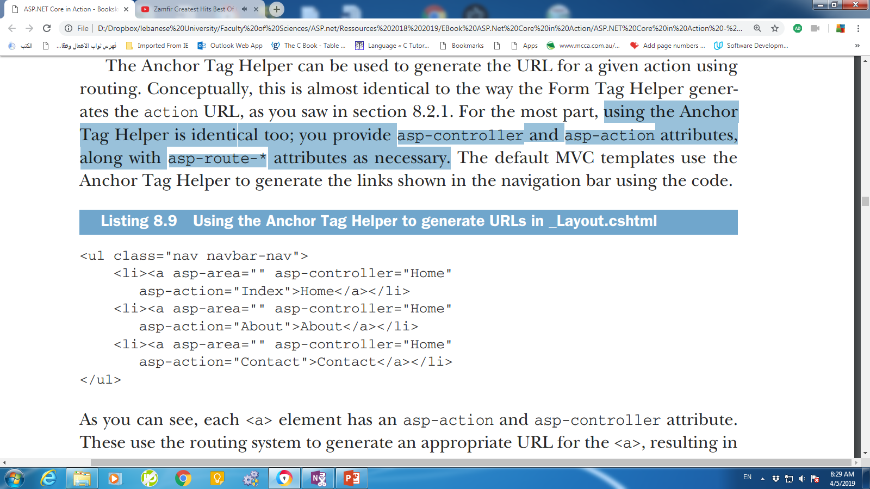
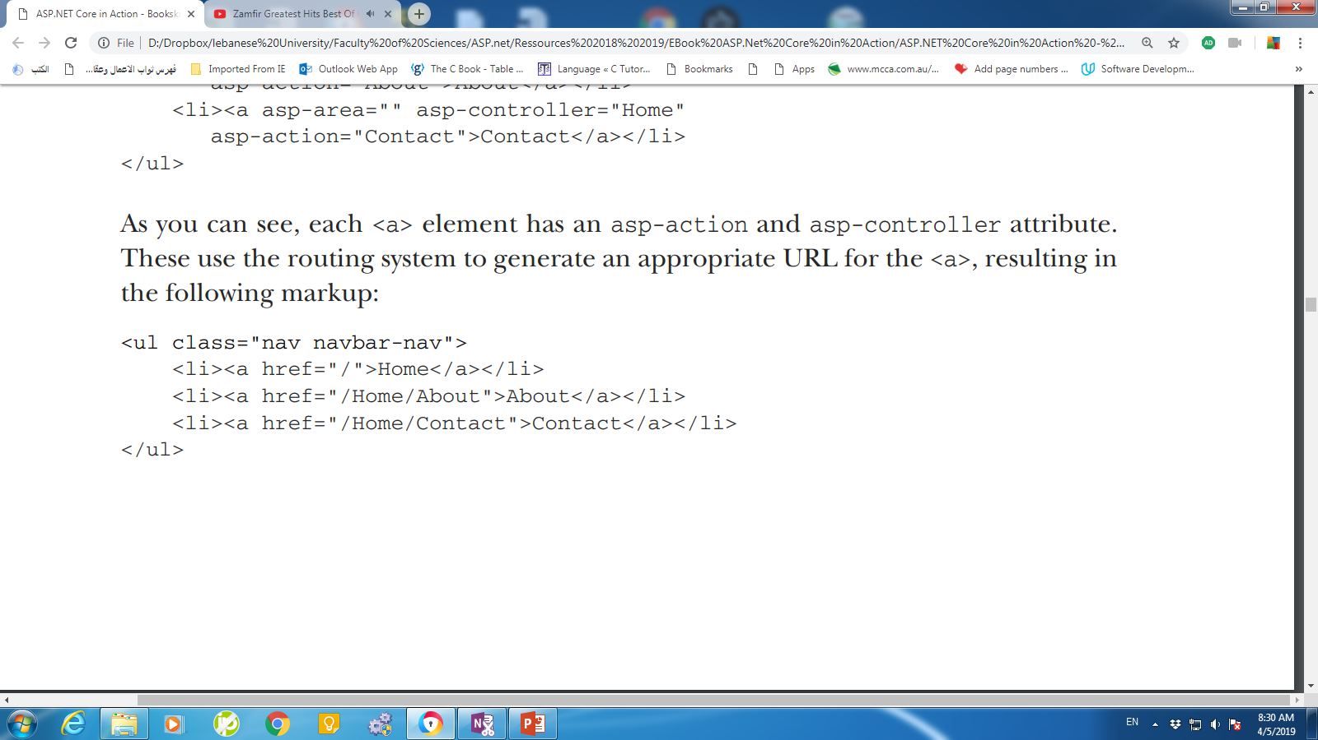
Generating links with the Anchor Tag Helper
The Anchor Tag Helper can be used to generate the URL for a given action using routing.
you provide asp-controller and asp-action attributes, along with asp-route-* attributes as necessary.
Notes:
The URLs use default values where possible, so the Index action on the HomeController generates the simple "/" URL instead of "/Home/Index"

Slide 29
Anchor tag Helper properties
asp-action—Sets the action route parameter.
asp-controller—Sets the controller route parameter.
asp-area—Sets the area route parameter to use. Areas can be used to provide an additional layer of organization to your application.
asp-host—If set, the link will point to the provided host and will generate an absolute URL instead of a relative URL.
asp-protocol—Sets whether to generate an http or https link. If set, it will generate an absolute URL instead of a relative URL.
asp-route—Uses the named route to generate the URL.
asp-route-*—Sets the route parameters to use during generation. Can be added multiple times for different route parameters.

Slide 30
Cache-busting with the Append Version Tag Helper
For performance reasons, browsers often cache files locally and reuse them for subsequent requests.
A cache-busting query string adds a query parameter to a URL, such as ?v=1. Browsers will cache the response and use it for subsequent requests to the URL.
When the resource changes, the query string is also changed, for example to ?v=2.
Browsers will see this is a request for a new resource, and will make a fresh request.
Notes:
A common problem with web development, both when developing and when an application goes into production, is ensuring that browsers are all using the latest files. For performance reasons, browsers often cache files locally and reuse them for subsequent requests, rather than calling your application every time a file is requested.

Slide 31
Append Tag Helper
<script src="~/js/site.js" asp-append-version="true"></script>
The asp-append-version attribute will load the file being referenced and generate a unique hash based on its contents. This is then appended as a unique query string to the resource URL:
<script src="/js/site.js?v=EWaMeWsJBYWmL2g_KkgXZQ5nPe"></script>

Slide 32
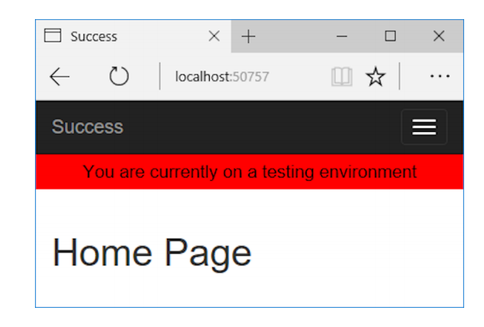
Using conditional markup with the Environment Tag Helper
In many cases, you want to render different HTML in your Razor templates depending if your website is running in a development or production environment.
@if(env == "Testing" || env == "Staging")
{
<div class="warning">You are currently on a testing environment</div>
}
<environment include="Testing,Staging">
<div class="warning">You are currently on a testing environment</div>
</environment>
Notes:
Instead of augmenting an existing HTML element using an asp- attribute, the whole element is the Tag Helper.

Slide 33
Summary
Tag Helpers let you bind your data model to HTML elements, making it easier to generate dynamic HTML while remaining editor friendly.
As with Razor in general, Tag Helpers are for server-side rendering of HTML only. You can’t use them directly in frontend frameworks, such as Angular or React.
Tag Helpers can be standalone elements or can attach to existing HTML using attributes.
Tag Helpers can customize the elements they’re attached to, add additional attributes, and customize how they’re rendered to HTML. This can greatly reduce the amount of markup you need to write.
Tag Helpers can expose multiple attributes on a single element.
You can add the asp-action and asp-controller attributes to the <form> element to set the action URL using the URL generation feature of the MVC middleware’s router.

Slide 34
Summary
You specify route values to use during routing with the Form Tag Helper using asp-route-* attributes.
The Form Tag Helper also generates a hidden field that you can use to prevent CSRF attacks.
You can attach the Label Tag Helper to a <label> using asp-for. It generates an appropriate for attribute and caption based on the [Display] DataAnnotations attribute and the view model property name.
The Input Tag Helper sets the type attribute of an <input> element to the appropriate value based on a bound property’s Type and any DataAnnotations applied to it. It also generates the data-val-* attributes required for client-side validation.

Slide 35
Summary
To enable client-side validation, you must add the necessary JavaScript files to your view for jQuery validation and unobtrusive validation.
The Select Tag Helper can generate drop-down <select> elements as well as list boxes, using the asp-for and asp-items attributes.
To generate a multiselect <select> element, bind the element to an IEnumerable property on the view model.
The items supplied in asp-for must be an IEnumerable<SelectListItem>.
You can generate an IEnumerable<SelectListItem> for an enum TEnum using the Html.GetEnumSelectList<TEnum>() helper method.

Slide 36
Summary
The Select Tag Helper will generate <optgroup> elements if the items supplied in asp-for have an associated SelectListGroup on the Group property.
Any extra additional <option> elements added to the Razor markup will be passed through to the final HTML. You can use these additional elements to easily add a “no selection” option to the <select> element.
The Validation Message Tag Helper is used to render the client- and server-side validation error messages for a given property.
Use the asp-validation-for attribute to attach the Validation Message Tag Helper to a <span>.

Slide 37
Summary
The Validation Summary Tag Helper is used to display validation errors for the model, as well as for individual properties.
Use the asp-validation-summary attribute to attach the Validation Summary Tag Helper to a <div>.
You can generate <a> URLs using the Anchor Tag Helper. This Helper uses routing to generate the href URL using asp-action, asp-controller, and asp-route-* attributes.
You can add the asp-append-version attribute to <link>, <script>, and <img> elements to provide cache-busting capabilities based on the file’s contents.
You can use the Environment Tag Helper to conditionally render different HTML based on the app’s current execution environment.

